Slide 1
Barter system
By Anya Kunder

Slide 2
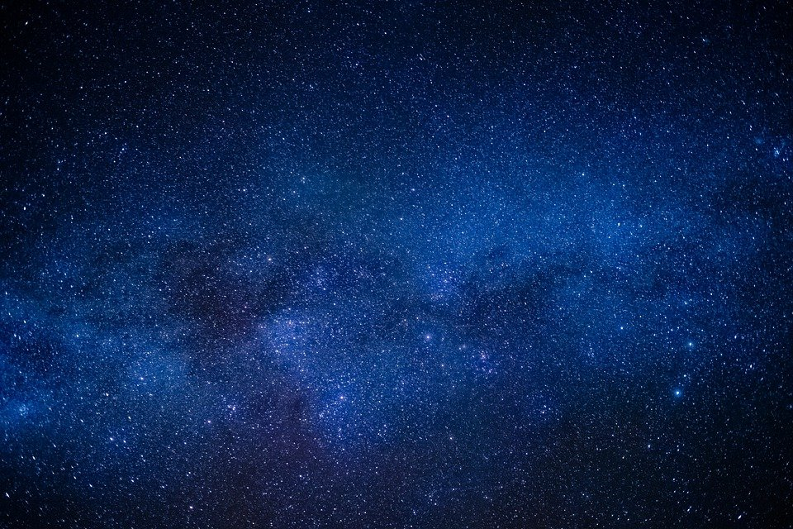
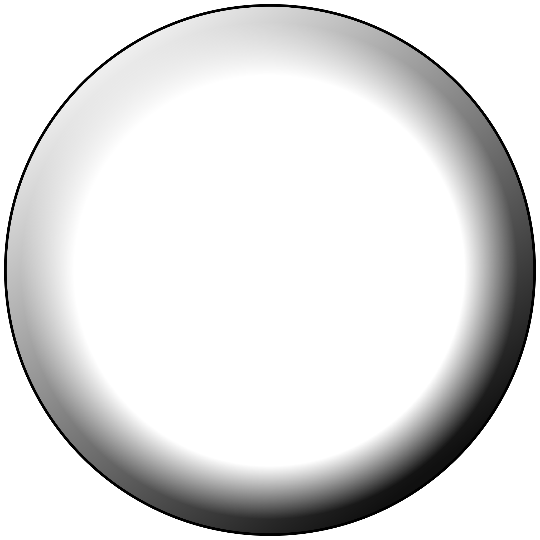
homescreen!
update
ISS location
meteor

Slide 3
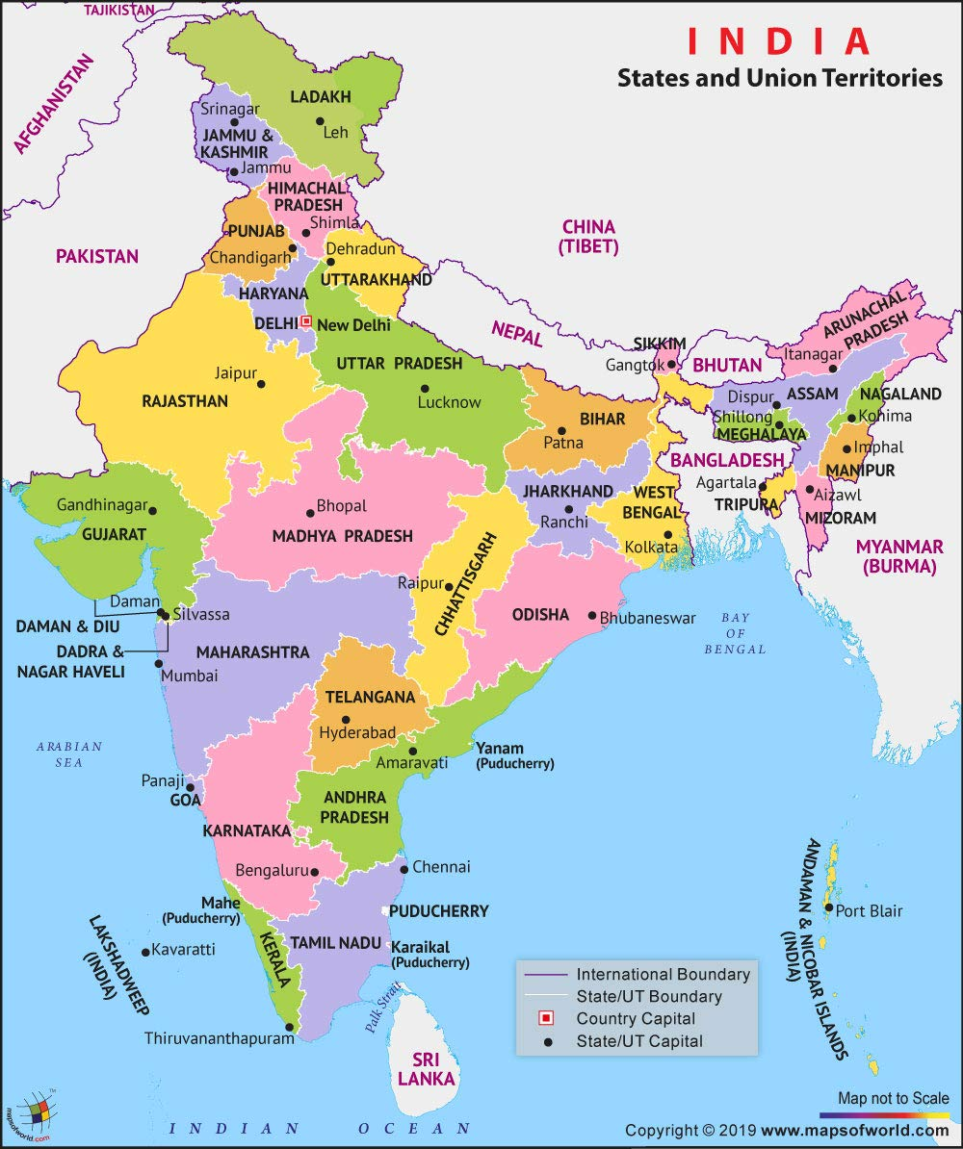
ISS location!

Slide 4
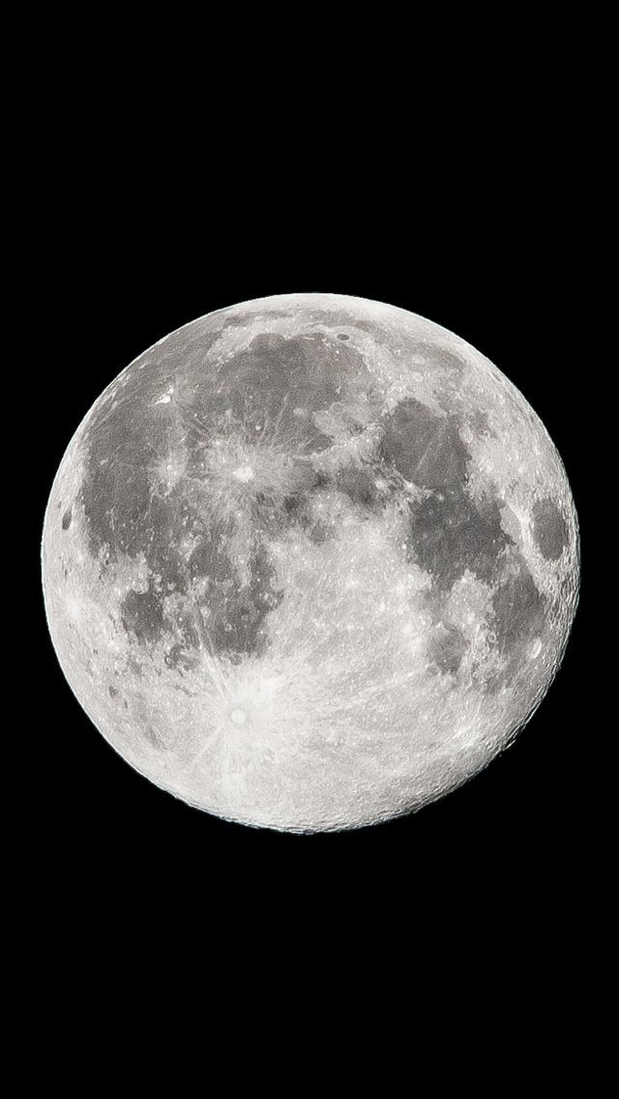
Update screen!
updates

Slide 5
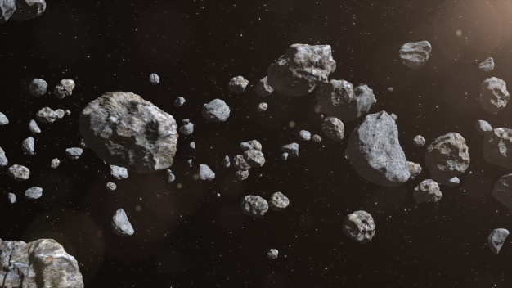
Meteor screen!
WELCOME TO THE METEOR SCREEN!

Slide 6
Homescreen user story!
I want my buttons to be in a vertical line with some gap between each. The format is like this so that the main focus when the screen is open are the buttons and the user knows exactly what to click.

Slide 7
ISS location user story!
For this screen I have a big picture of a map so that the user can easily access a location without any difficulties.

Slide 8
Update screen user story!
This screen has a picture of a moon, a title and a small white box available for notifications about updates. This is so that it will be easier to access the notifications and the screen is in a aesthetic format.

Slide 9
Meteor screen!
The meteor screen is similar to the update screen it to is designed like that for easy access, and the information will be displayed in the white box provided.

